Slide 1
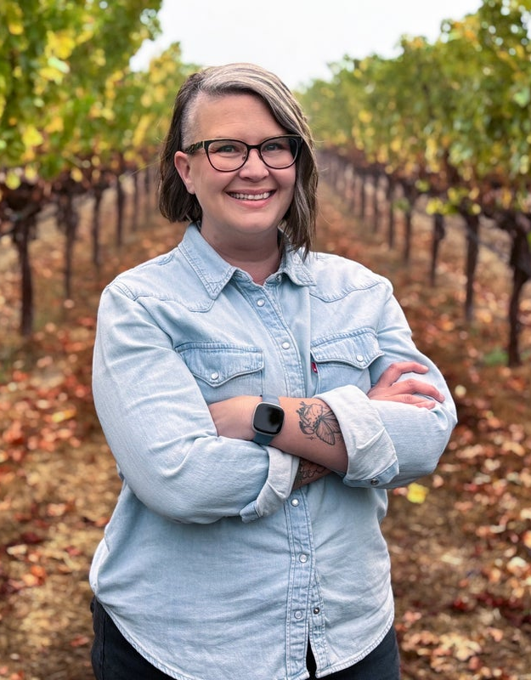
EMILY HAINES
WINEMAKER
Emily Haines’ attention to detail, deft touch and keen palate are what allow her to bring out the best of each vintage and vineyard to craft Quattro Theory’s expressive, food-friendly wines.
Emily started her winemaking career in 2008 at Wahluke Wine Company and quickly rose to director of winemaking for its Milbrandt Vineyard. She oversaw the brand’s white wine program, including a cool-climate Chardonnay, and crafted approachable yet age-worthy, Bordeaux-varietal red wines, ultimately earning multiple 90+ scores from top critics.
She then joined Terra d’Oro in Amador as senior winemaker, attracted by the opportunity to work with winery’s estate vineyard holdings and growers from other historic vineyards, and over her seven-year tenure, refined the brand’s terroir-driven wines.
Her years of experience in both the vineyard and cellar provided a perfect foundation for the precise, small-lot approach at Quattro Theory. “Every decision, from growing season to bottling, has an impact on the wine in the glass,” she says, “and I appreciate having the ability at Quattro Theory to precisely tailor our practices—in how we farm, harvest, crush, ferment and age—for each lot. This allows us to protect and highlight the aromatics and flavors unique to each, and to produce expressive, balanced wines that not only drink well now, but will drink well years from now.”
,

